Slide 1
Testing the Equipotential Magnetic Field Line Assumption Using Interhemispheric SuperDARN Measurements
Joseph Baker¹, Bharat Kunduri¹, Lasse Clausen¹, Mike Ruohoniemi¹ Adrian Grocott², Mervyn Freeman³
¹Virginia Tech, ²University of Leicester, ³British Antarctic Survey

Slide 2
Outline
Testing the Equipotential Magnetic Field Line Assumption Using:
SuperDARN and Cluster EDI Measurements
- Magnetosphere-Ionosphere Scaling Parameter
Interhemispheric auroral zone SuperDARN Measurements
- Three events with substantial IMF Bx/By asymmetries
- Interhemispheric field-aligned currents
Interhemispheric subauroral SuperDARN Measurements
- August 4th 2010 SAPS event
- Asymmetry in global field-aligned currents

Slide 3
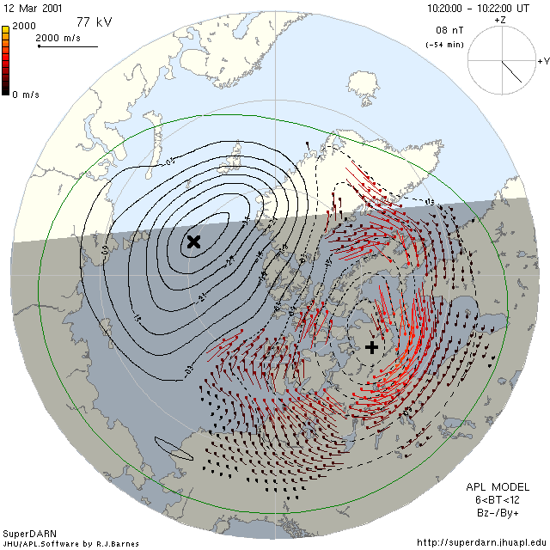
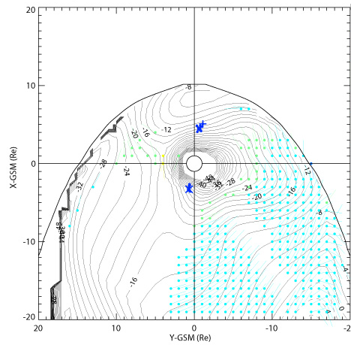
Equipotential B-Field Lines?
Does this magnetic field line projection of ionospheric convection measurements produce a believable representation of the state of magnetospheric convection?

Slide 4
EDI-SuperDARN Study

Slide 5
EDI-SuperDARN Study
APPROACH:
The Electron Drift Instrument aboard the Cluster spacecraft obtains ExB drift measurements using a technique analogous to SuperDARN.
Use an empirical magnetic field model (Tsyganenko T01) to identify the magnetic footpoint of the Cluster spacecraft in the ionosphere.
Check to see if there are simultaneous SuperDARN measurements in the close vicinity of the Cluster ionospheric footpoint.
Calculate an EDI estimate for what the ionospheric velocity should be at the footpoint location assuming equipotential magnetic field lines.
Compare the EDI estimate with the SuperDARN measurements:
Compare measurements along radar line-of-sight directions
Compare EDI and SuperDARN convection patterns
Calculate a magnetosphere-ionosphere scaling parameter

Slide 6
EDI-SuperDARN Locations

Slide 7
VLOS Comparison

Slide 8
VLOS Distributions
SuperDARN VLOS distribution is truncated because of ground-scatter bias

Slide 9
M-I Scaling Factor
A magnetosphere-ionosphere scaling factor can be calculated for those cases when the EDI projected velocity is approximately aligned along the SuperDARN radar line-of-sight.
On average, 24% of convection measured by EDI is not measured in the ionosphere.
However, the peak of the distribution is actually slightly less than unity.

Slide 10
Southward IMF

Slide 11
Northward IMF
Reverse cells??
Reverse cells!!

Slide 12
Interhemispheric SuperDARN Study

Slide 13
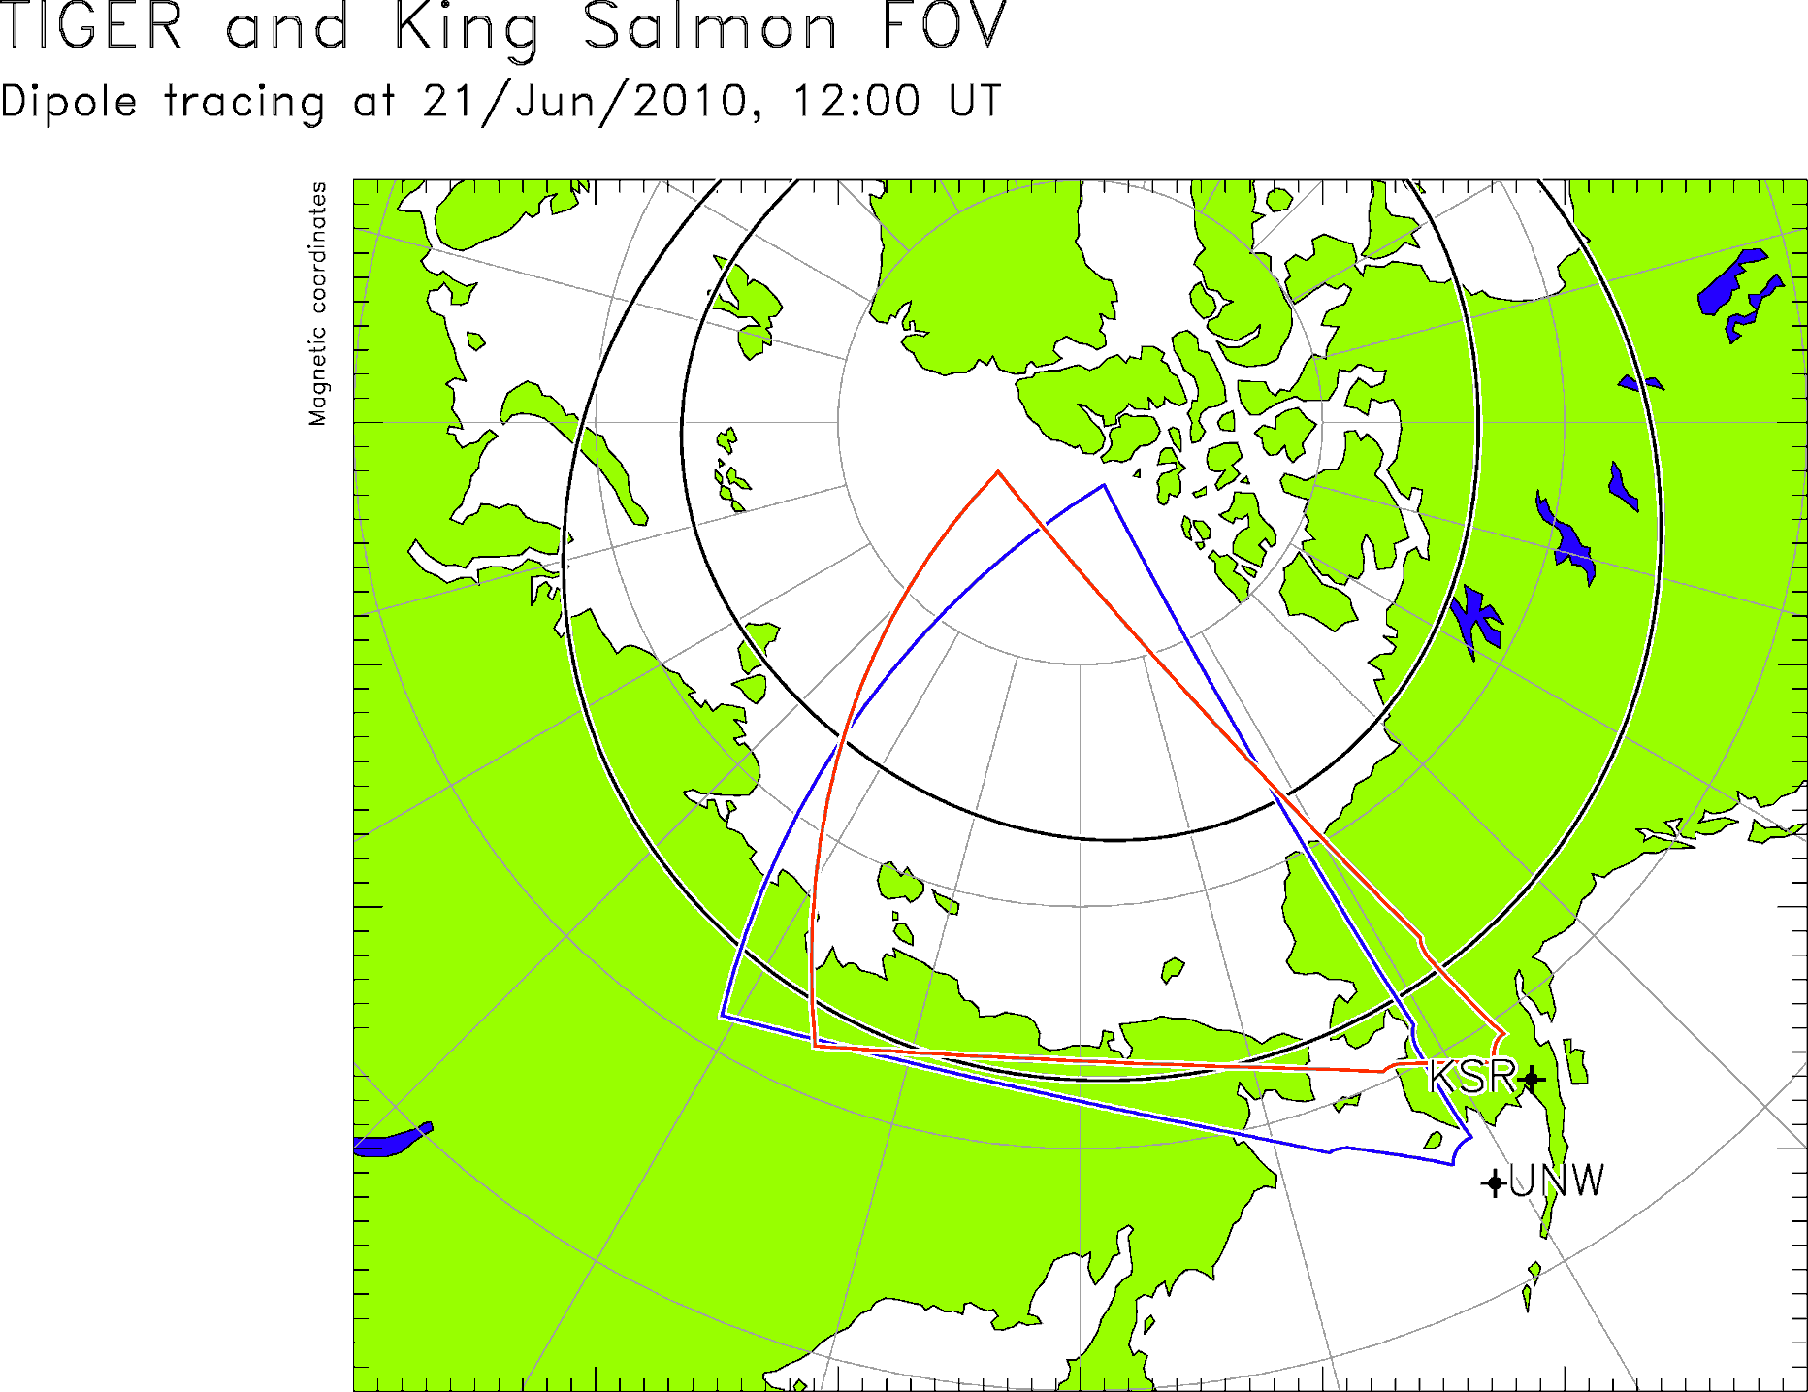
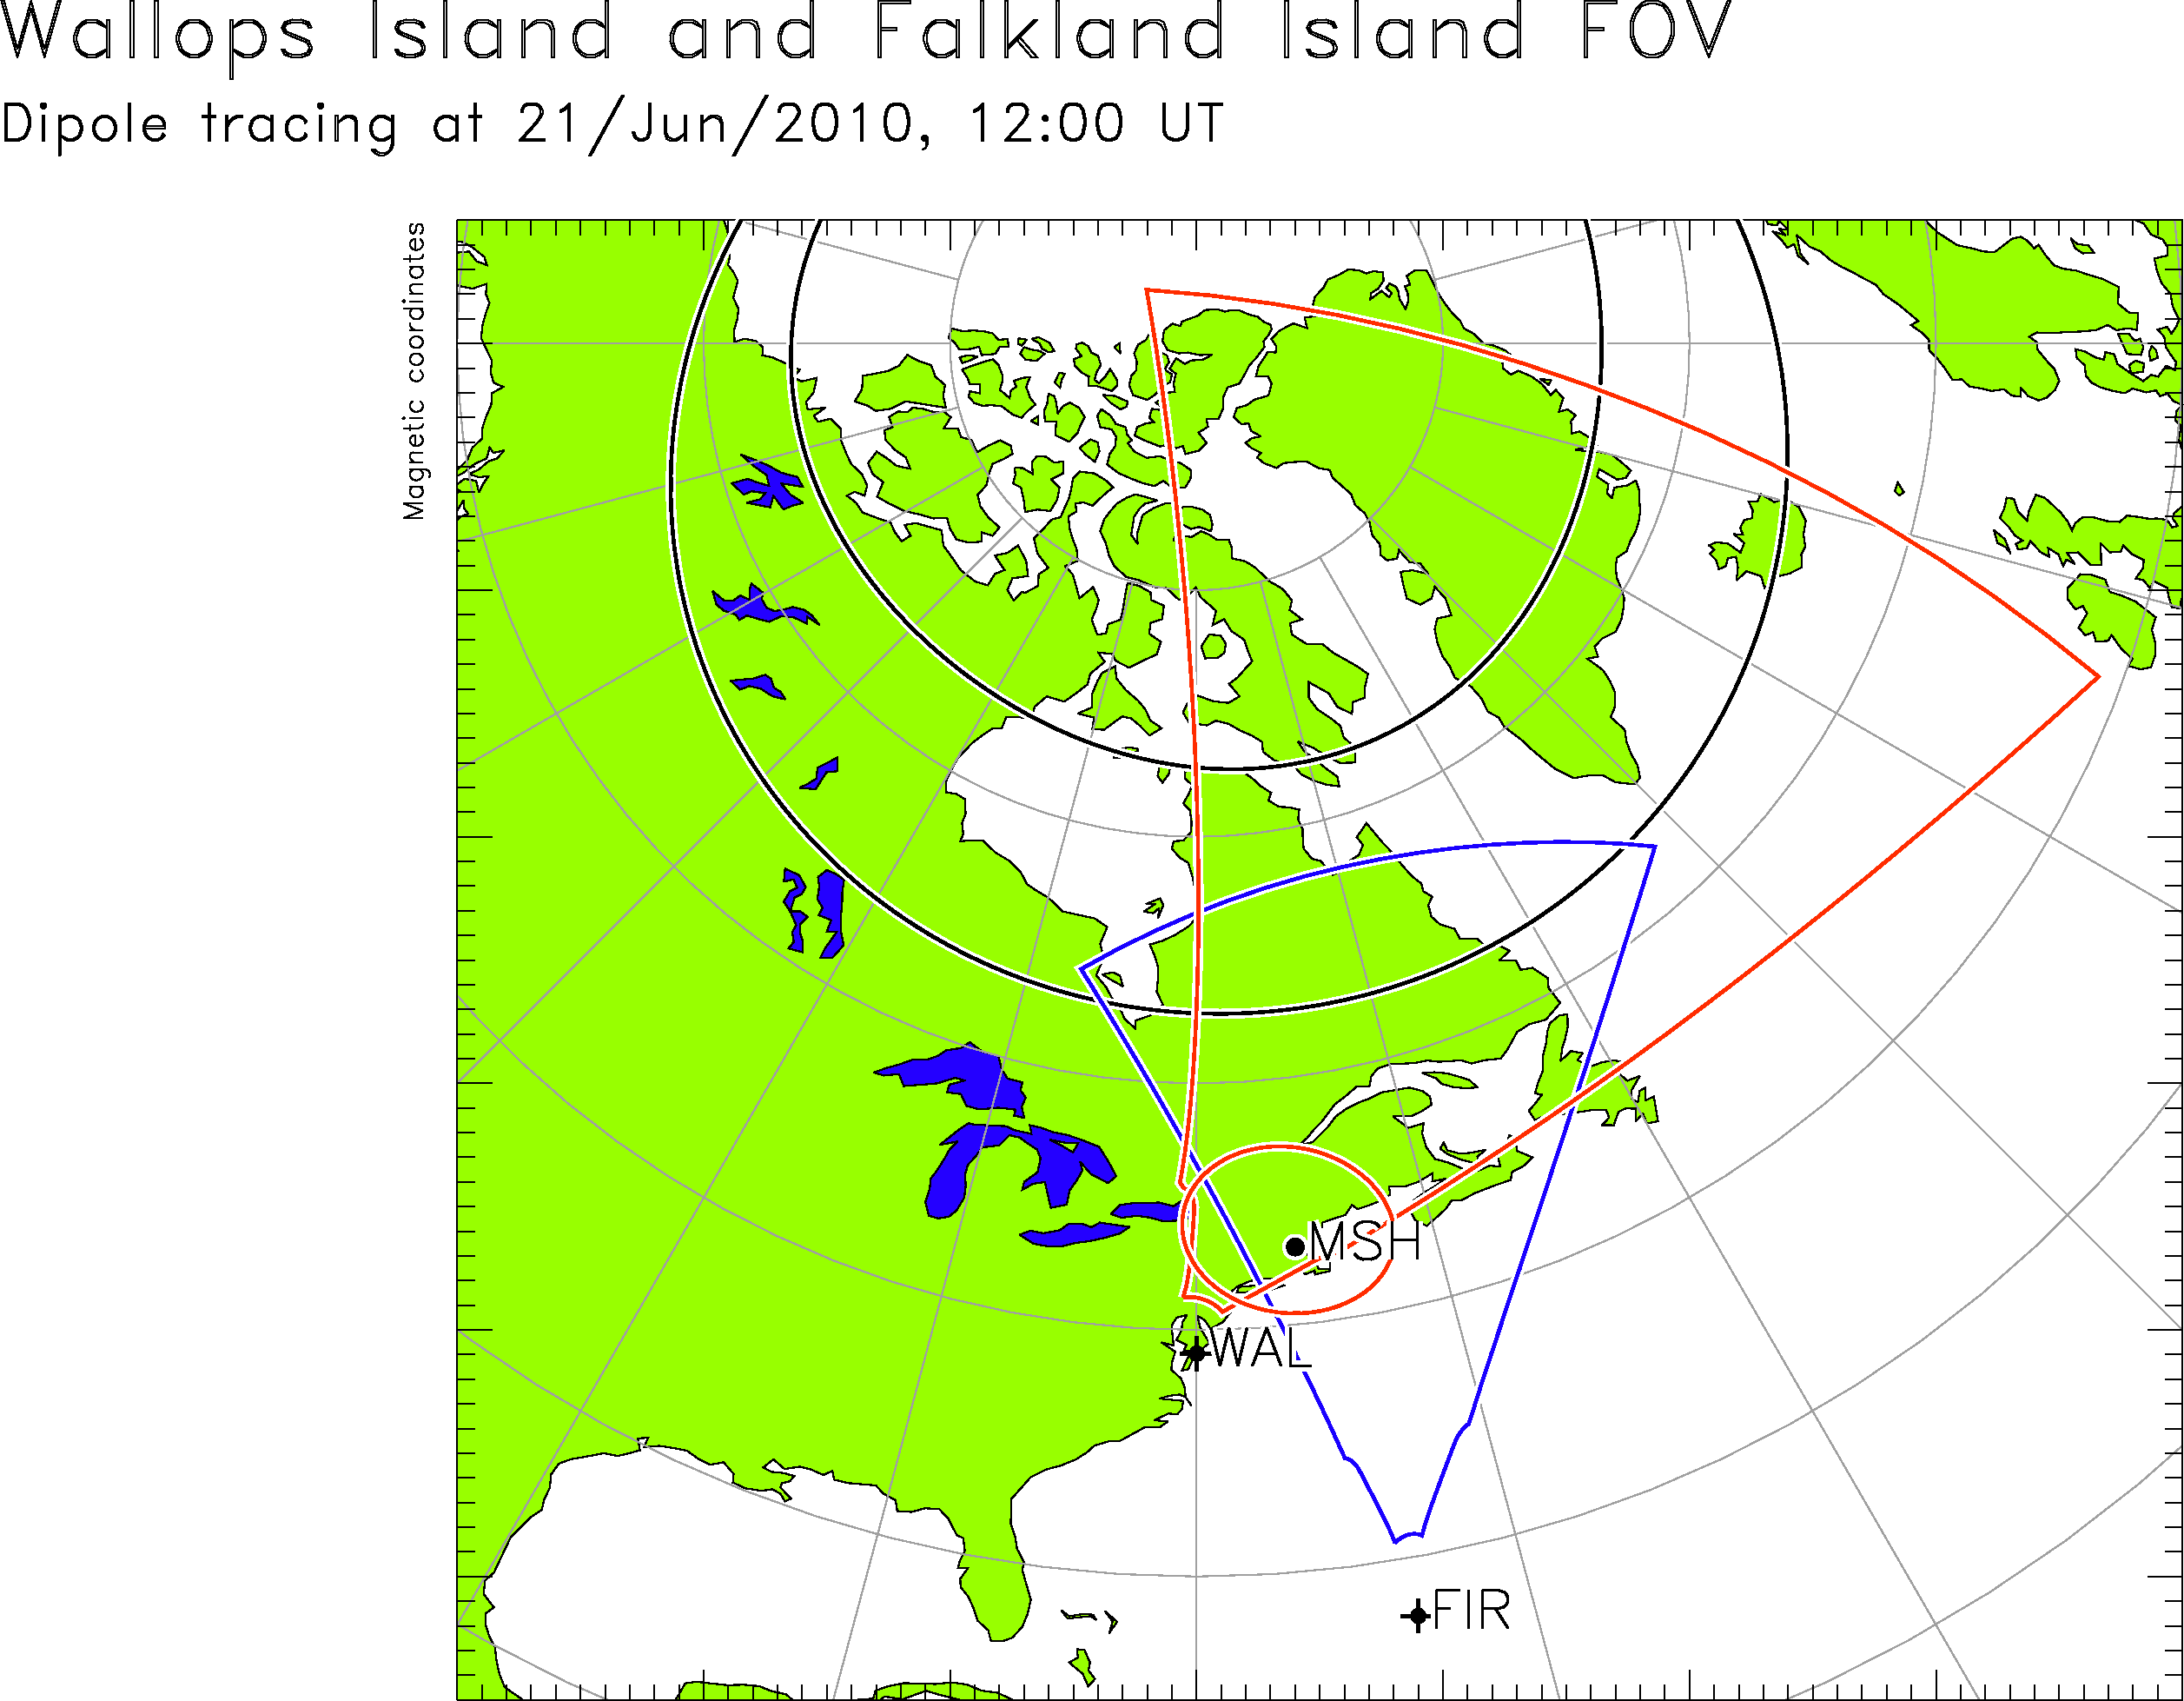
Conjugate Radar FOVs
The validity of the equipotential assumption can also be examined using SuperDARN radars with nominally conjugate fields-of-view:
KSR-UNW, FIR-WAL, HAN-KER, GBR-HAL, STO-SYS, PYK-SYE
APPROACH: Identify periods when ionospheric scatter is observed by conjugate radars in both hemispheres simultaneously and examine the consistency between the flows.
NOTE: Inconsistencies might be expected for relatively large IMF Bx and By conditions.

Slide 14
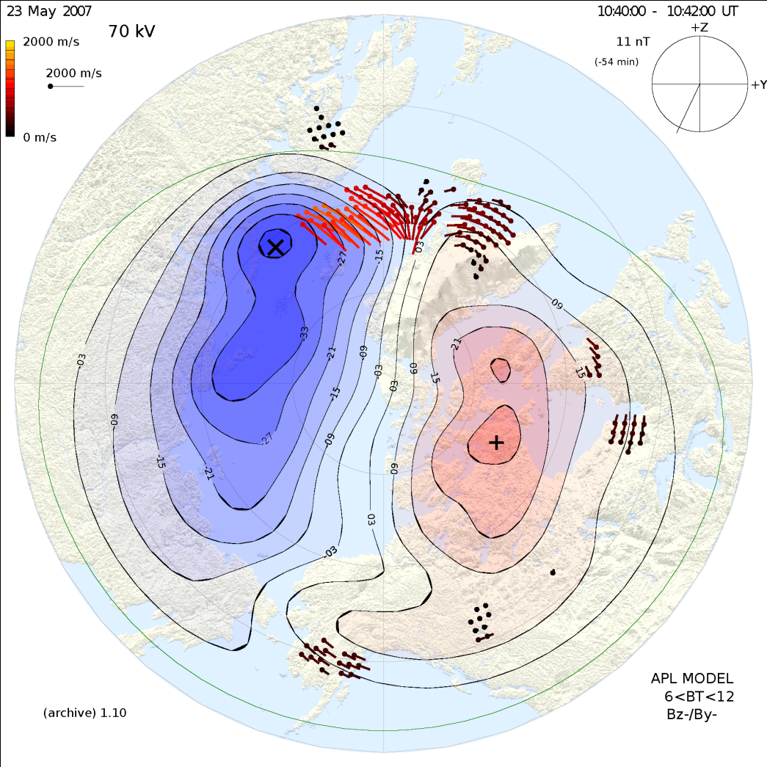
20070523: 1040-1042 UT
Convection in the noon throat is substantially stronger in the southern hemisphere
IMF is dominantly southward but also with a substantial negative By value

Slide 15
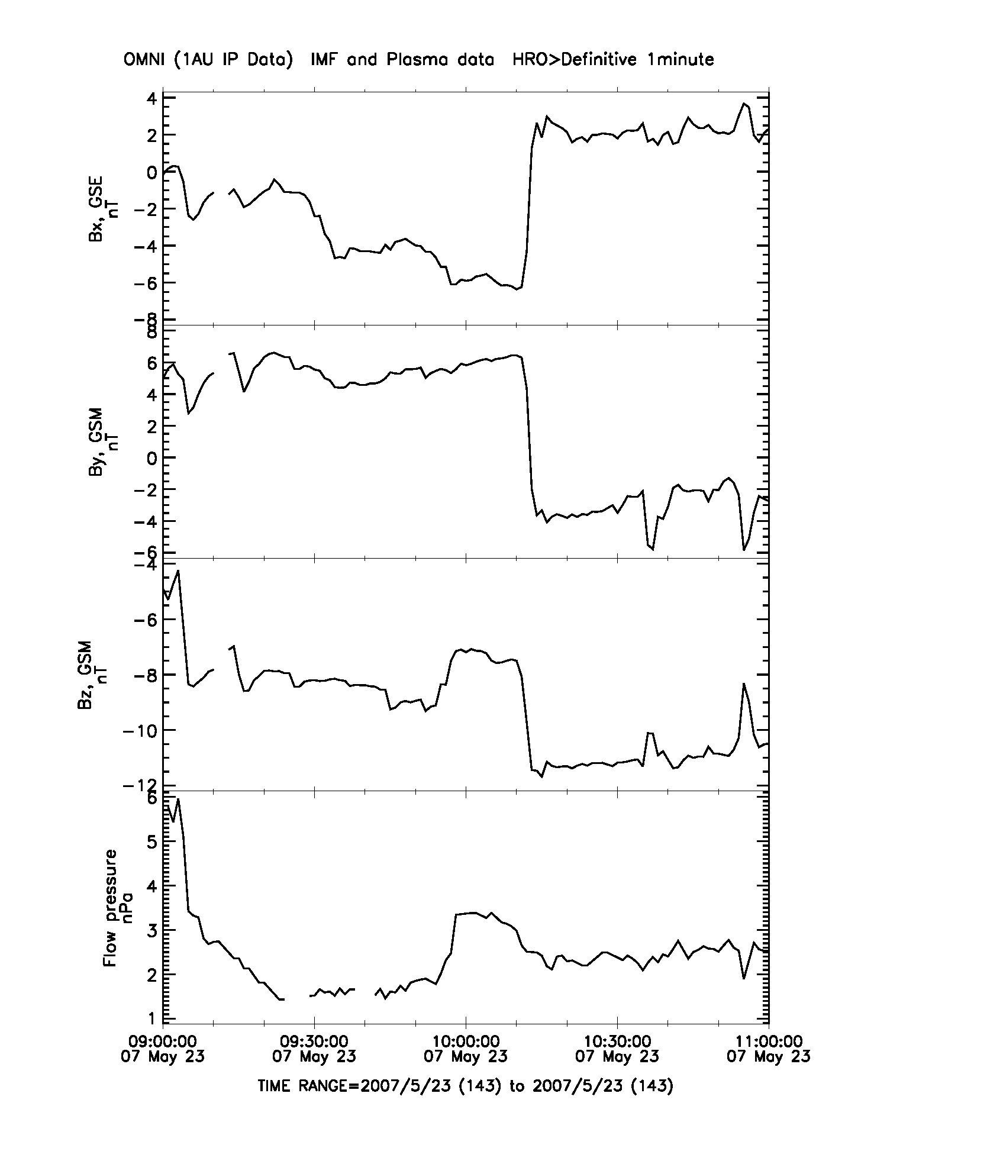
20070523: 9-11 UT
Pykkvibaer beam-8
Syowa East beam-8
Bx
Positive Bx turning
By
Negative By turning
Bz
Sustained Southward Bz
DP
IMF Bx Asymmetry?

Slide 16
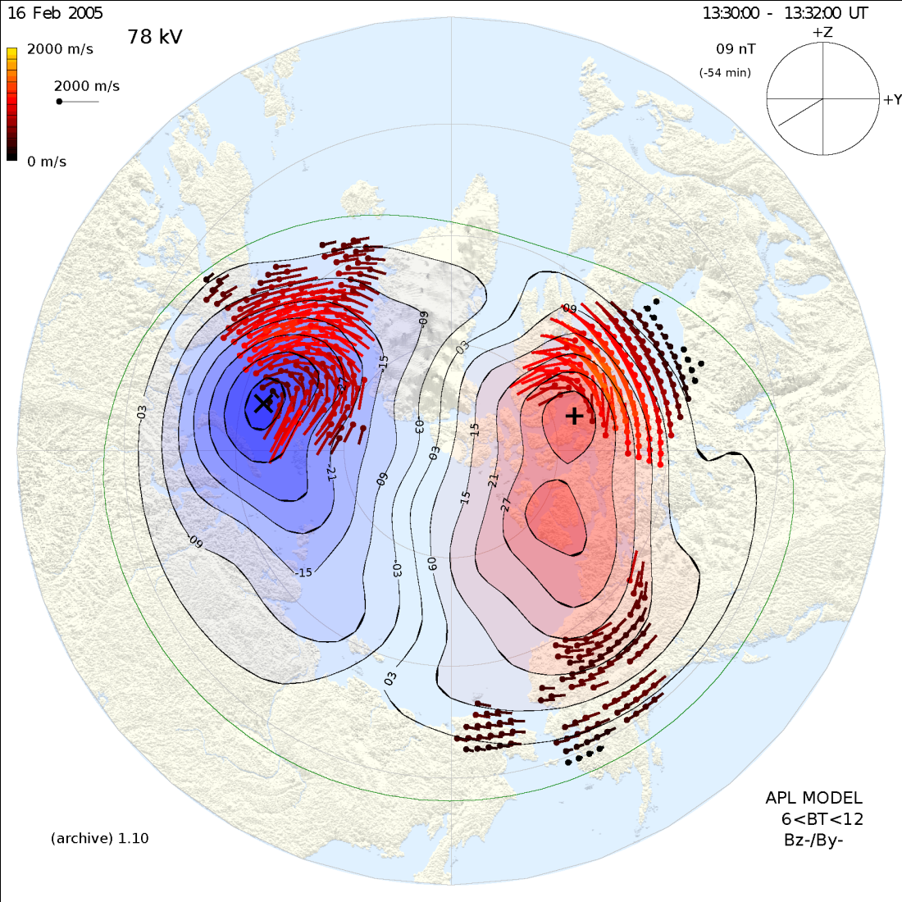
20050216: 1330-1332 UT
Afternoon convection is much stronger in the southern hemisphere
IMF condition is dominant negative By with a substantial southward component

Slide 17
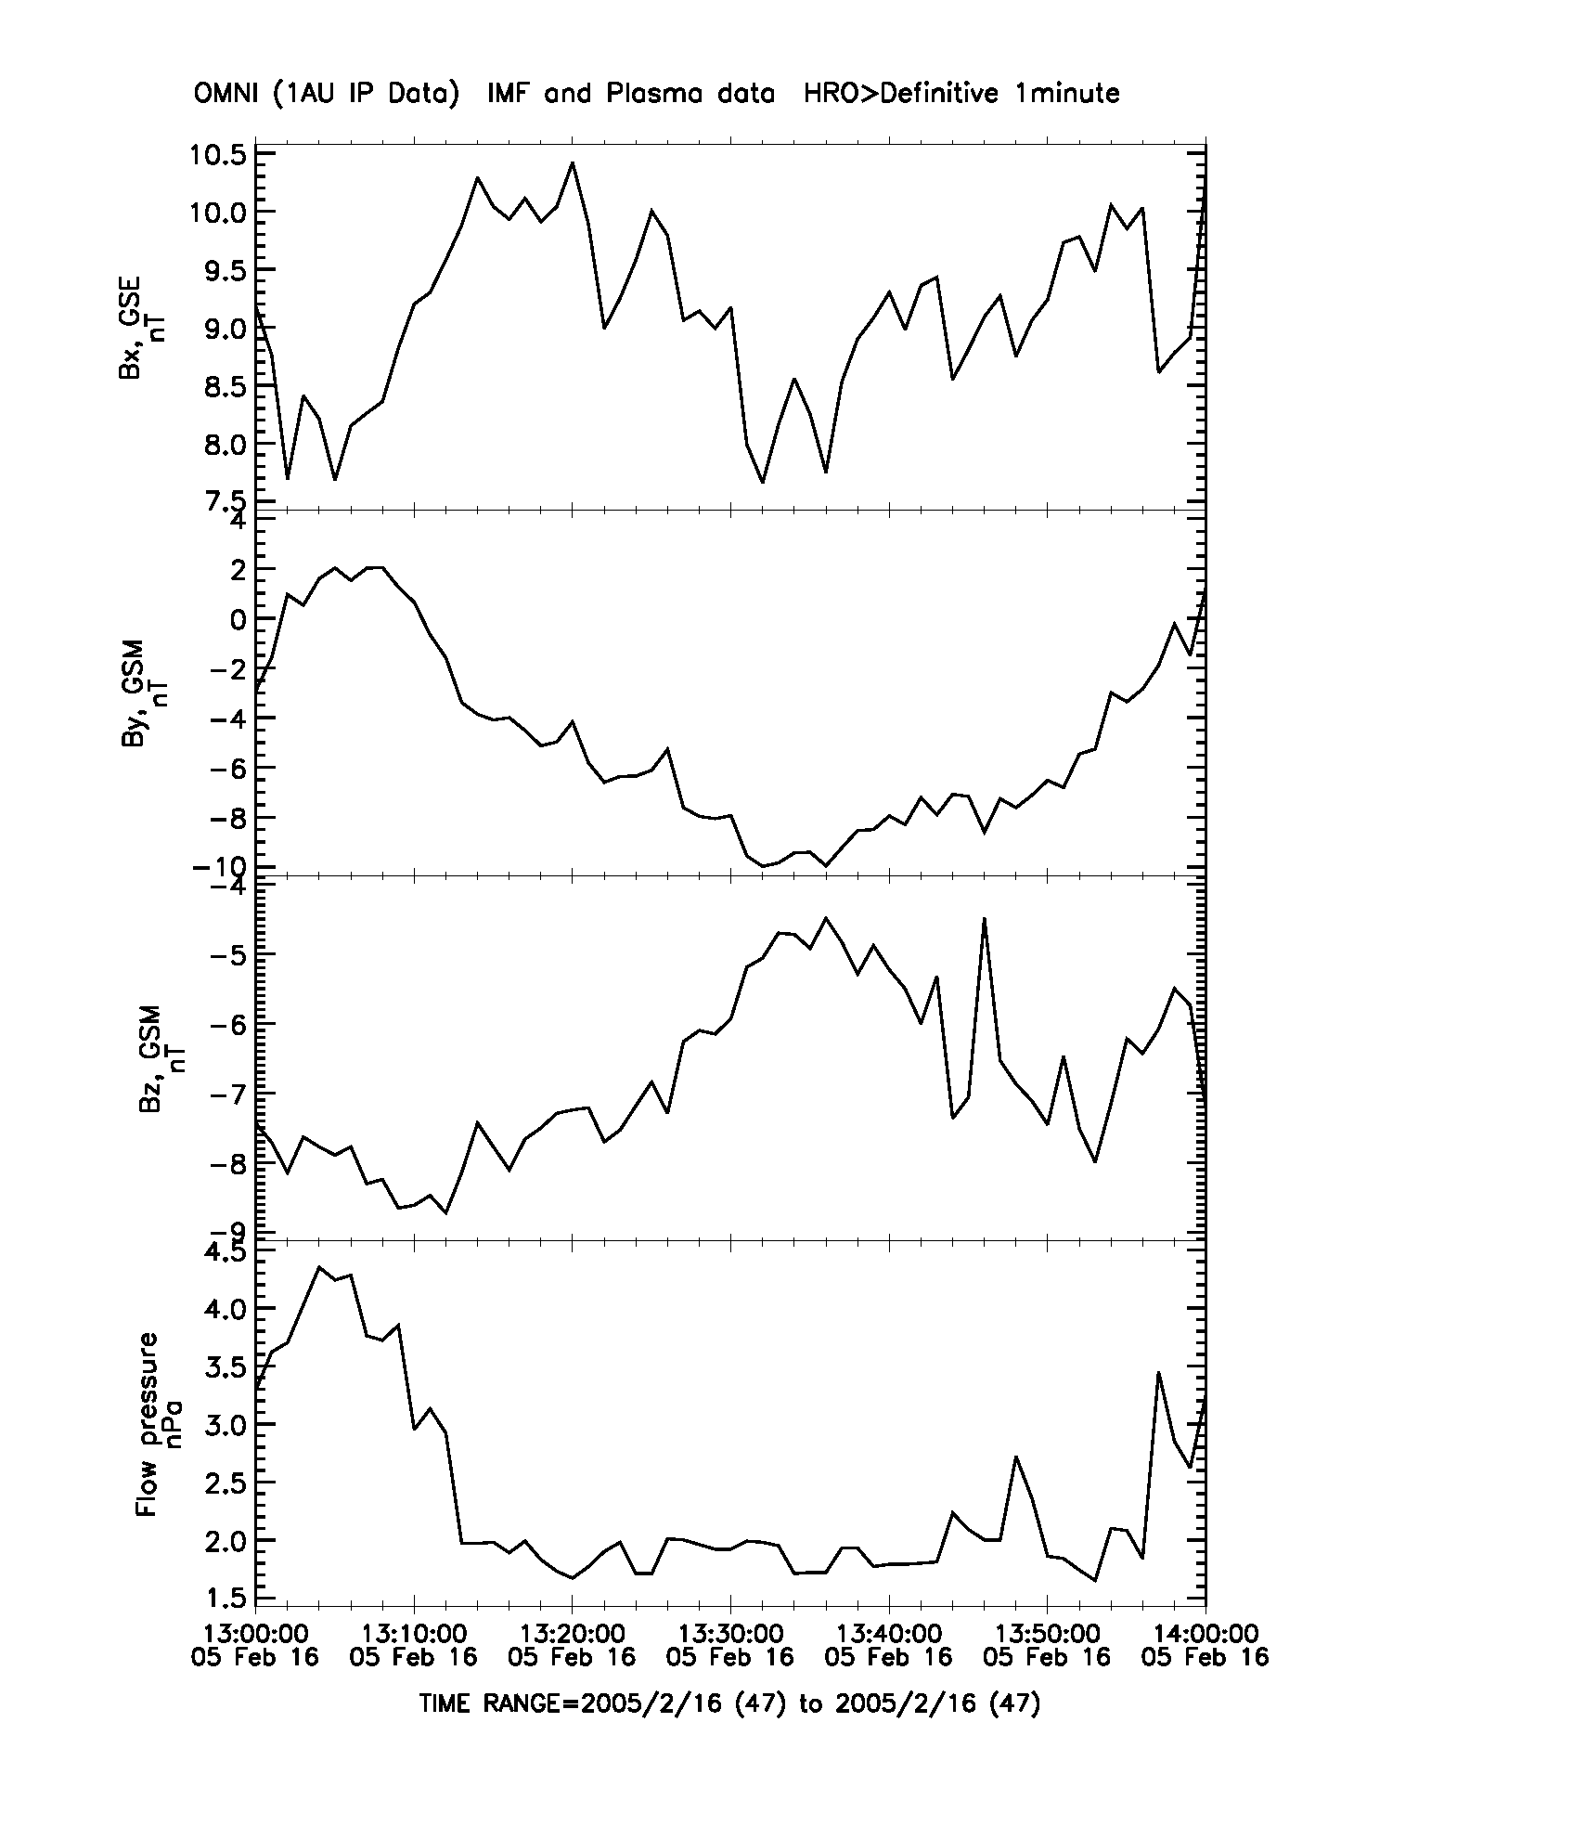
20050216: 13-14 UT
Hankasalmi beam-8
Kerguelen beam-8
Bx
Sustained Positive Bx
By
Increasing Negative By
Bz
Positive (Weakening) Bz
DP

Slide 18
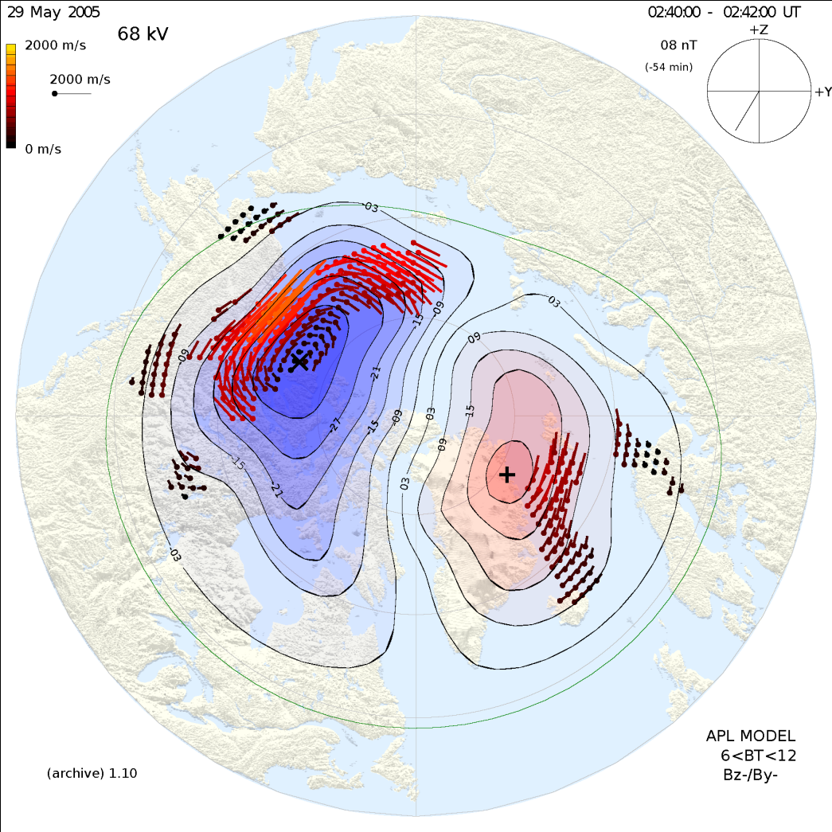
20050529: 0240-0242 UT
Afternoon convection is slightly stronger in the southern hemisphere
IMF is dominantly southward but also with a substantial negative By value

Slide 19
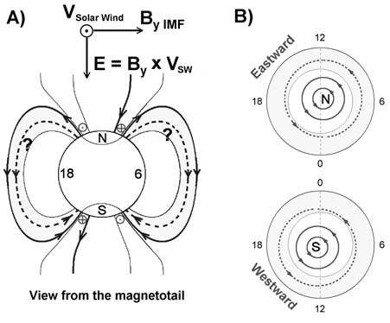
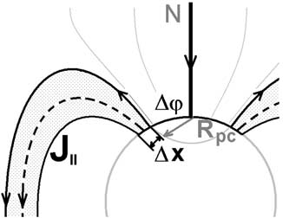
Interhemispheric FACs
A strong IMF By component is expected to penetrate the dayside magnetosphere and produce an interhemispheric field-aligned current system.
For strong negative IMF By [ Kozlovsky et al., 2003]:
NORTHERN HEMISPHERE:
Downward FAC in center of polar cap
Outward FAC in afternoon closed field line region
Eastward convection in afternoon sector
Suppressed sunward afternoon convection
SOUTHERN HEMISPHERE:
Upward FAC in center of polar cap
Downward FAC in afternoon closed field line region
Westward convection in afternoon sector
Enhanced sunward afternoon convection

Slide 20
20050529: 0240-0242 UT
Afternoon convection is stronger in the southern hemisphere than northern hemisphere
IMF is southward with a moderate negative By value

Slide 21
20050529: 0240-0242 UT
Interhemispheric currents reinforce afternoon convection in southern hemisphere
Interhemispheric currents counteract afternoon convection in northern hemisphere

Slide 22
20050216: 1330-1332 UT
Afternoon convection is much stronger in the southern hemisphere
IMF is dominant By negative

Slide 23
20050216: 1330-1332 UT
Interhemispheric currents reinforce afternoon convection in southern hemisphere
Interhemispheric currents counteract afternoon convection in northern hemisphere

Slide 24
August 4th 2010 SAPS Event

Slide 25
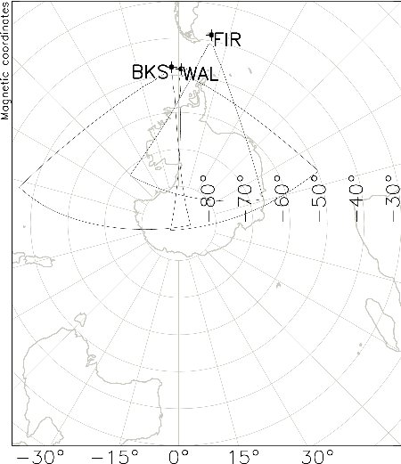
FIR-BKS-WAL FOVs
Interhemispheric conjugacy of SAPS/SAID events can be examined with mid-latitude radars.
Here, we present preliminary results of an examination of the interhemispheric conjugacy of the same SAPS/SAID event presented by Adrian Grocott on Thursday.

Slide 26
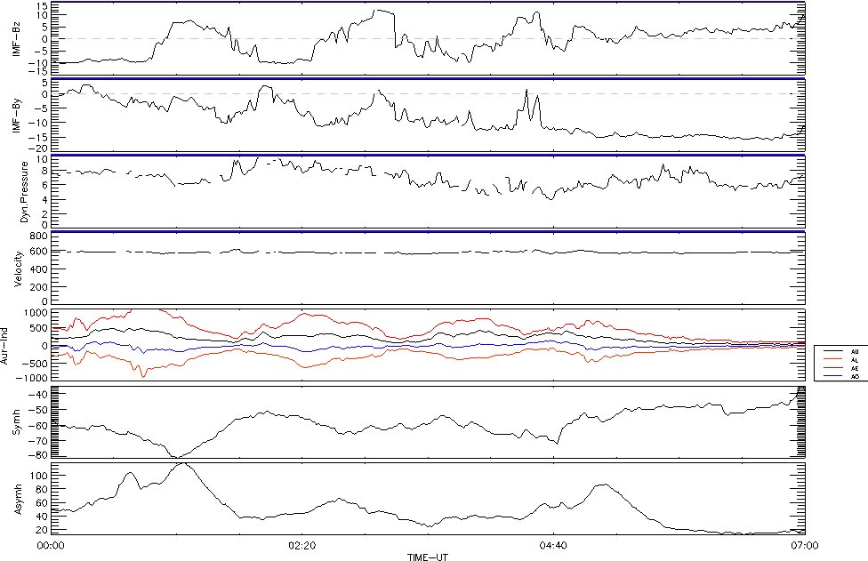
SAID: August 4th 2010
IMF Bz
IMF By
Dynamic Pressure
SW Vel
AL/AE/AU
Sym-H
Asym-H

Slide 27
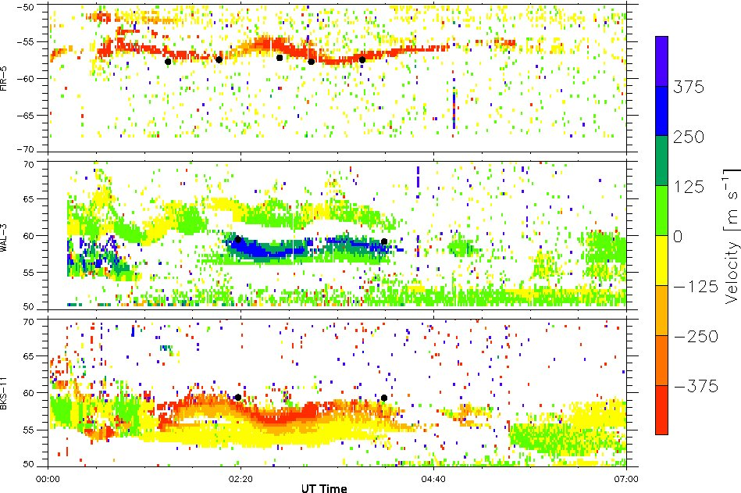
Interhemispheric SAID Measurements
FIR Beam-5
WAL Beam-3
BKS Beam-11

Slide 28
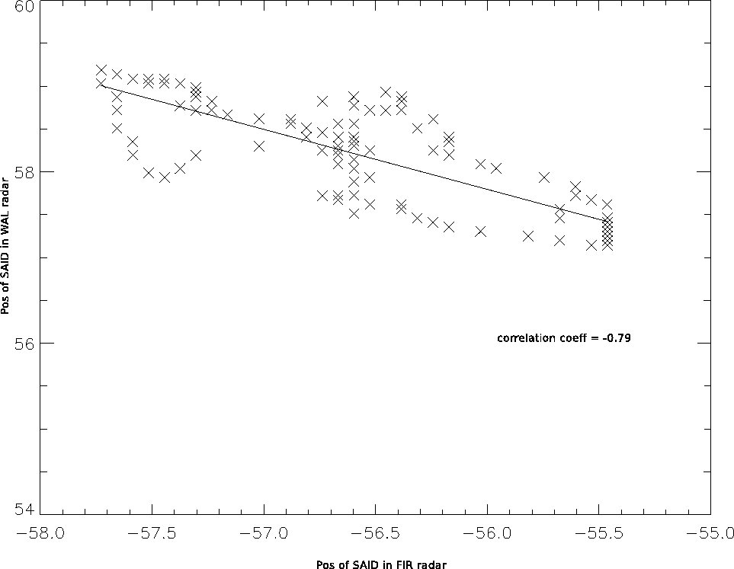
SAID Latitude: WAL Vs FIR
Lat of SAID (Wallops)
Lat of SAID (Falkland Islands)
The latitudinal motion of the SAPS/SAID channel is highly correlated between the hemispheres.

Slide 29
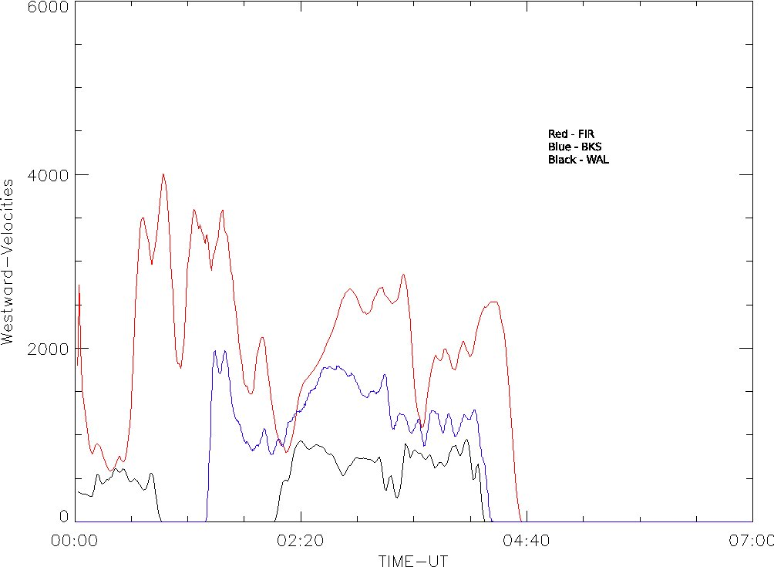
FIR-BKS-WAL Velocities
RED = FIR
BLUE = BKS
BLACK = WAL
WESTWARD VELOCITY (m/s)
Universal Time on August 4th 2010
The dynamics of the flow variations within the SAPS/SAID channels are also correlated between the hemispheres.
BUT: the magnitude of the flows seen by the northern radars tends to be lower.

Slide 30
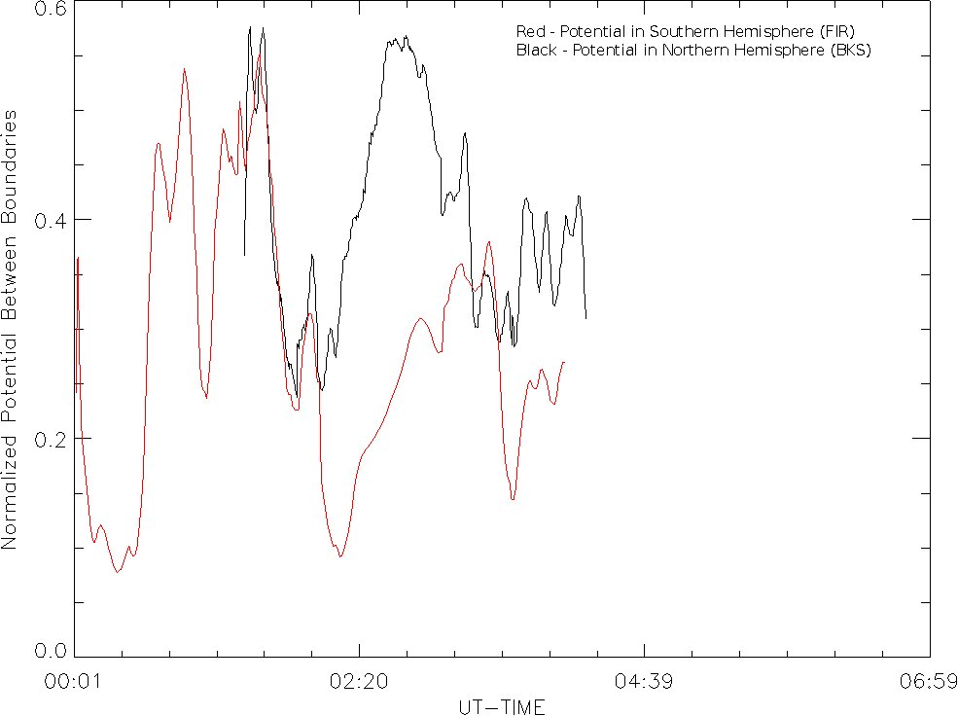
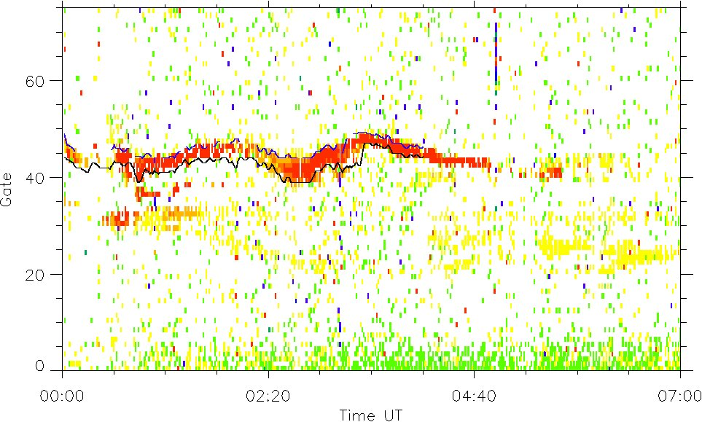
Cross-SAID Potential Drops
SAID PD
RED = FIR SAID PD BLACK = BKS SAID PD
GATE
FIR SAID Channel Thickness
GATE
BKS SAID Channel Thickness
Universal Time on August 4th 2010
Some interhemispheric difference in SAID velocities could possibly be attributed to the thinner width of the SAID in the southern hemisphere and the fact that the magnetic field strength is weaker because of the South Atlantic Anomaly.
The potential differences across the SAID channels are indeed better correlated than the drift velocities, but there are still substantial interhemispheric differences.

Slide 31
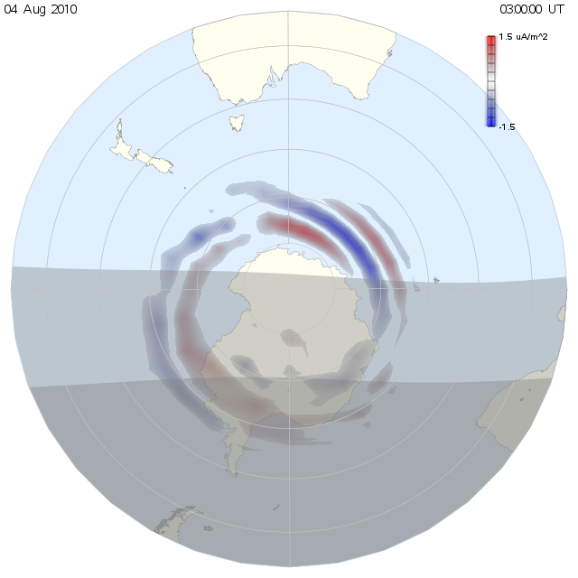
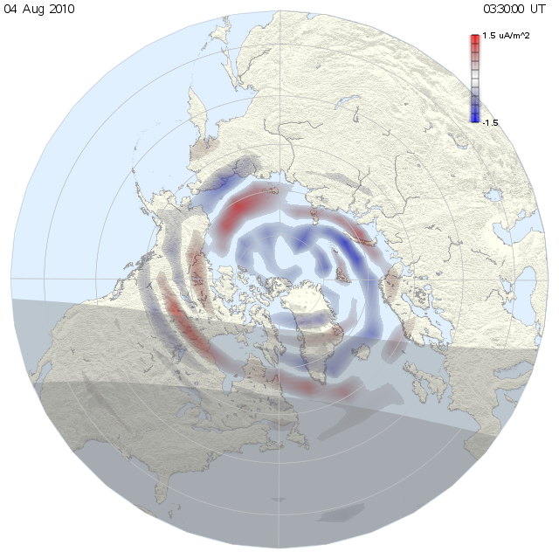
AMPERE FACs
A preliminary examination of AMPERE data during this period shows there are substantial interhemispheric asymmetries in the global field-aligned currents.
The interhemispheric SAID differences are thus likely due to asymmetric driving.

Slide 32
Summary
EDI-SuperDARN Study:
On average, 24% of the convection measured by Cluster EDI at high altitude is not measured by SuperDARN in the ionosphere.
During northward IMF the reverse convection cells measured by EDI at high altitude are much more pronounced than those measured by SuperDARN.
Interhemispheric SuperDARN Study:
A strong interhemispheric asymmetry in cusp convection during one event was clearly attributed to the sign of the IMF Bx component.
Strong interhemispheric asymmetries in the afternoon sector convection during two other events were attributed to interhemispheric field-aligned currents produced by a strong negative IMF By component.
Strong interhemispheric asymmetries in the strength of convection during the August 4th 2010 SAPS/SAID event are likely associated with asymmetries in the large-scale field-aligned current system seen by AMPERE (Future Work!!)

Slide 33
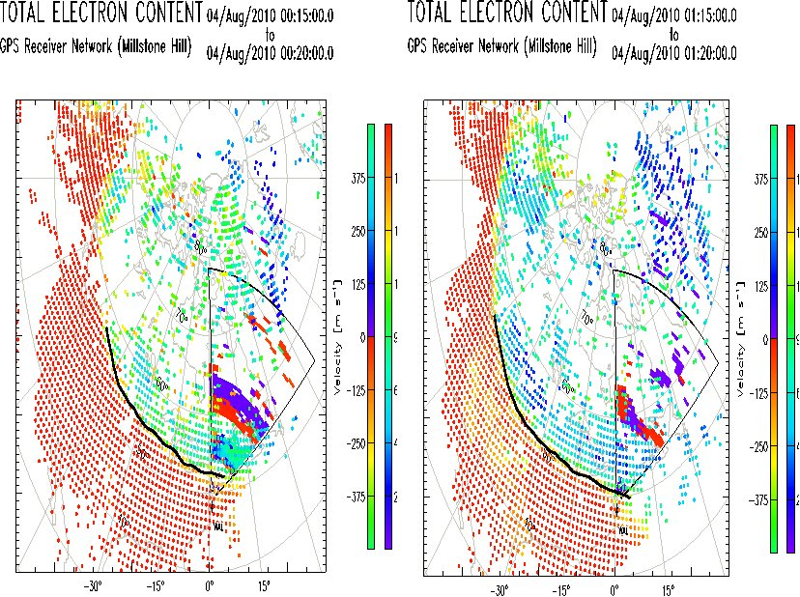
Total Electron Content
The SAPS/SAID feature is located just poleward of the high-low TEC boundary

